Slide 1
Lesson 3 Dead Reckoning and Odometry
AI for Mobile Robots - CSIP5202:
Intelligent Mobile Robotics (IMR)
Dr. Aboozar Taherkhani (PhD)
email: aboozar.taherkhani@dmu.ac.uk

Slide 2
Learning outcomes
Dead Reckoning
Wheel rotation sensor: wheel Encoder
Odometry in practice
Notes:
ROS is an open source robotic software system that can be used without licensing fees by universities, government agencies, and commercial companies.
These packages are supported by the Open Source Robotics Foundation (OSRF),
http://www.ros.org/about-ros/

Slide 3
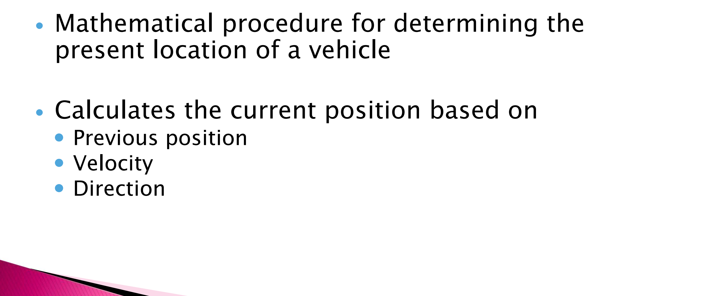
Dead Reckoning
Dead reckoning is a navigation method used to estimate a robot's or vehicle's current position based on a previously known position, its speed, direction, and elapsed time. It doesn’t take into account external factors such as wind or other navigation influences.

Slide 4
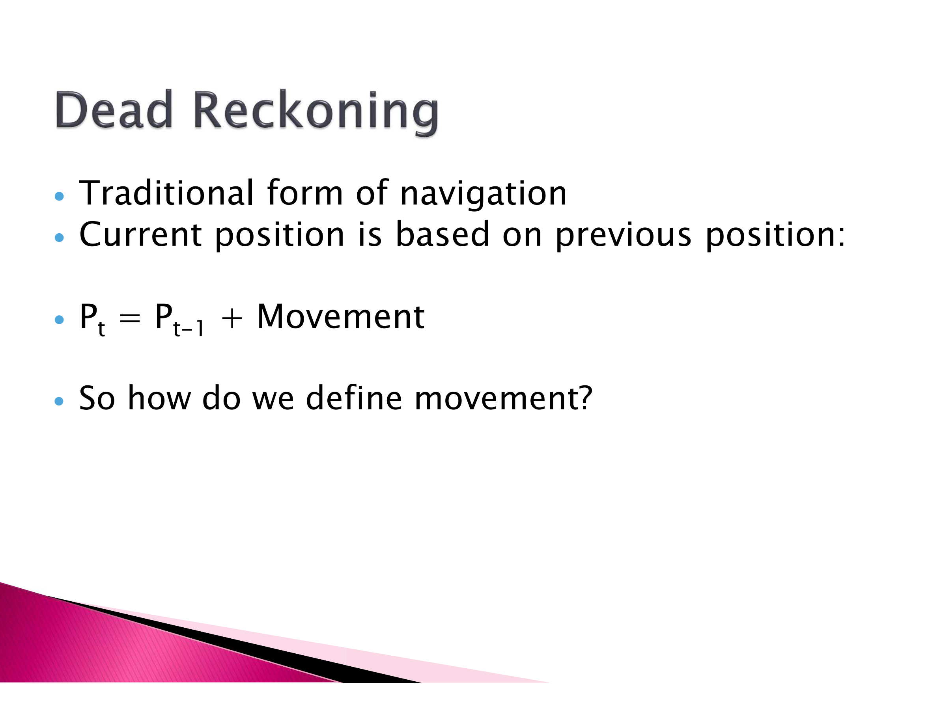

Slide 5
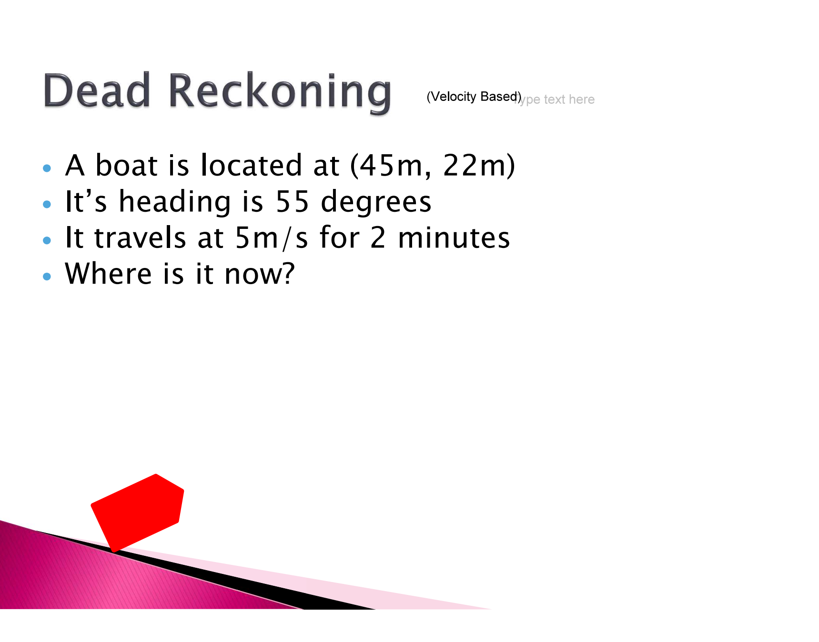

Slide 6
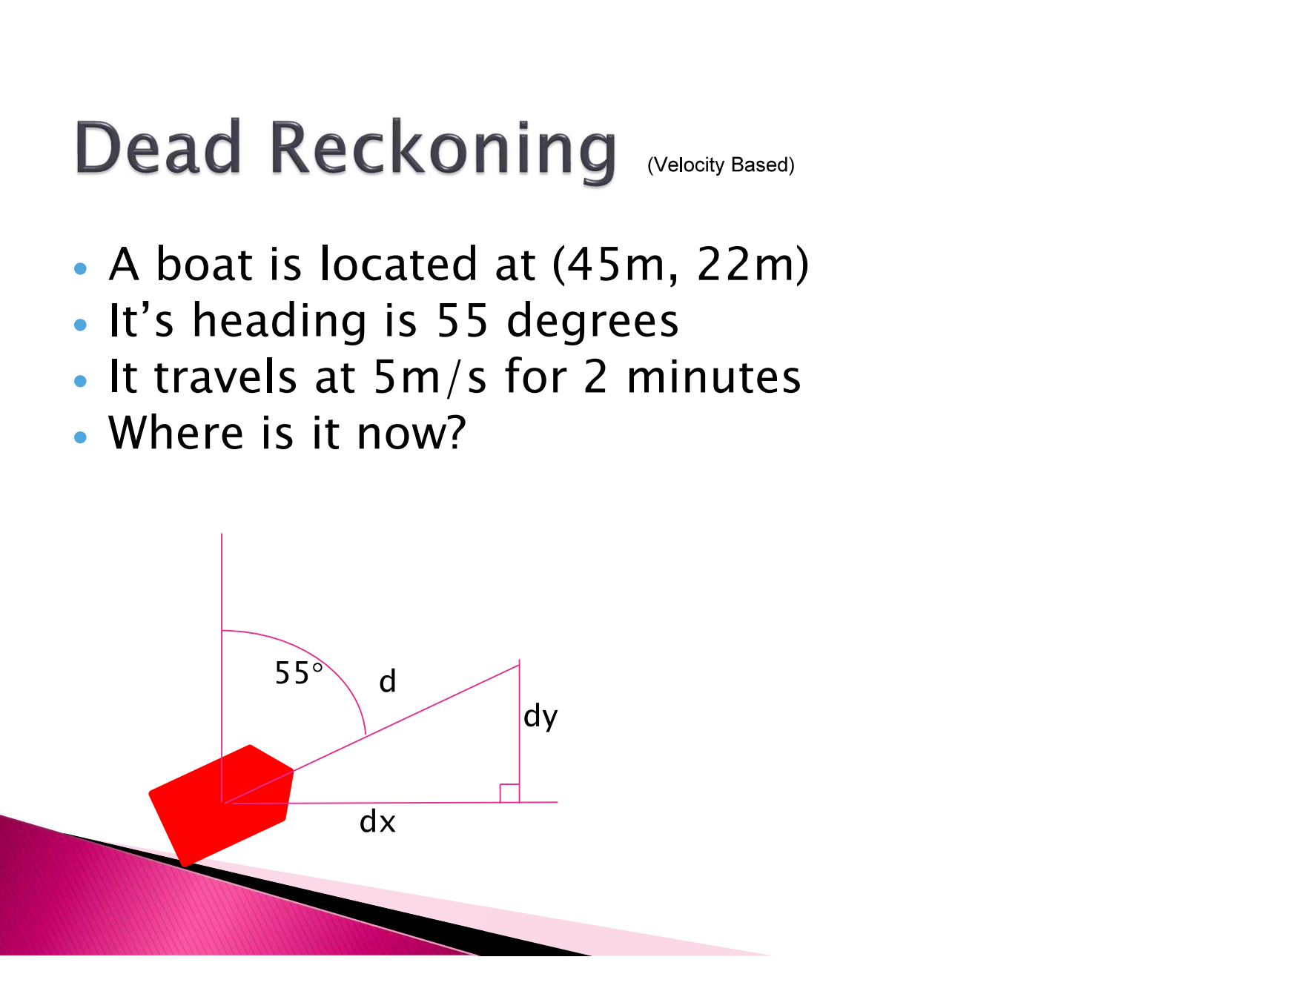

Slide 7
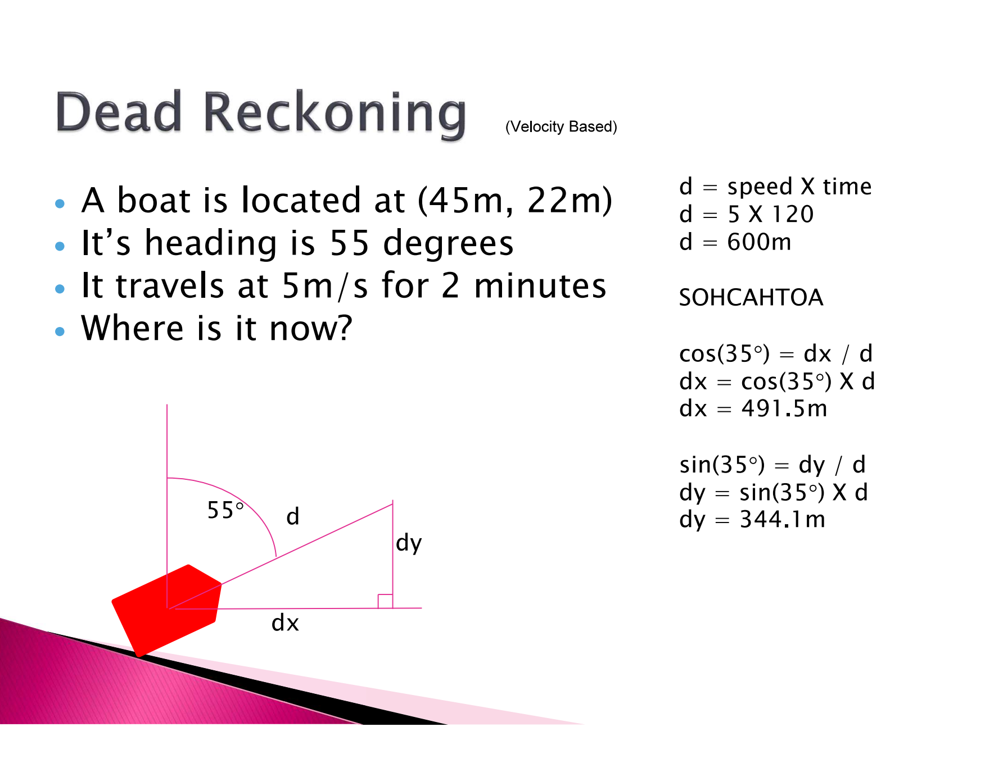

Slide 8
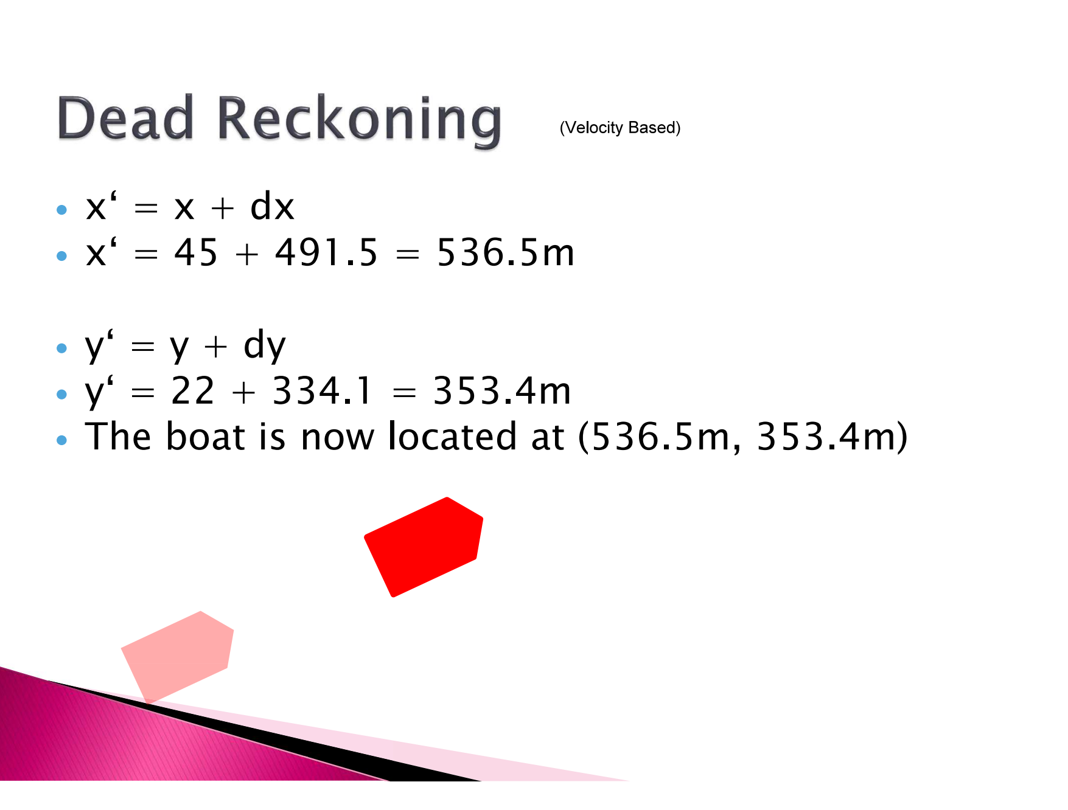

Slide 9
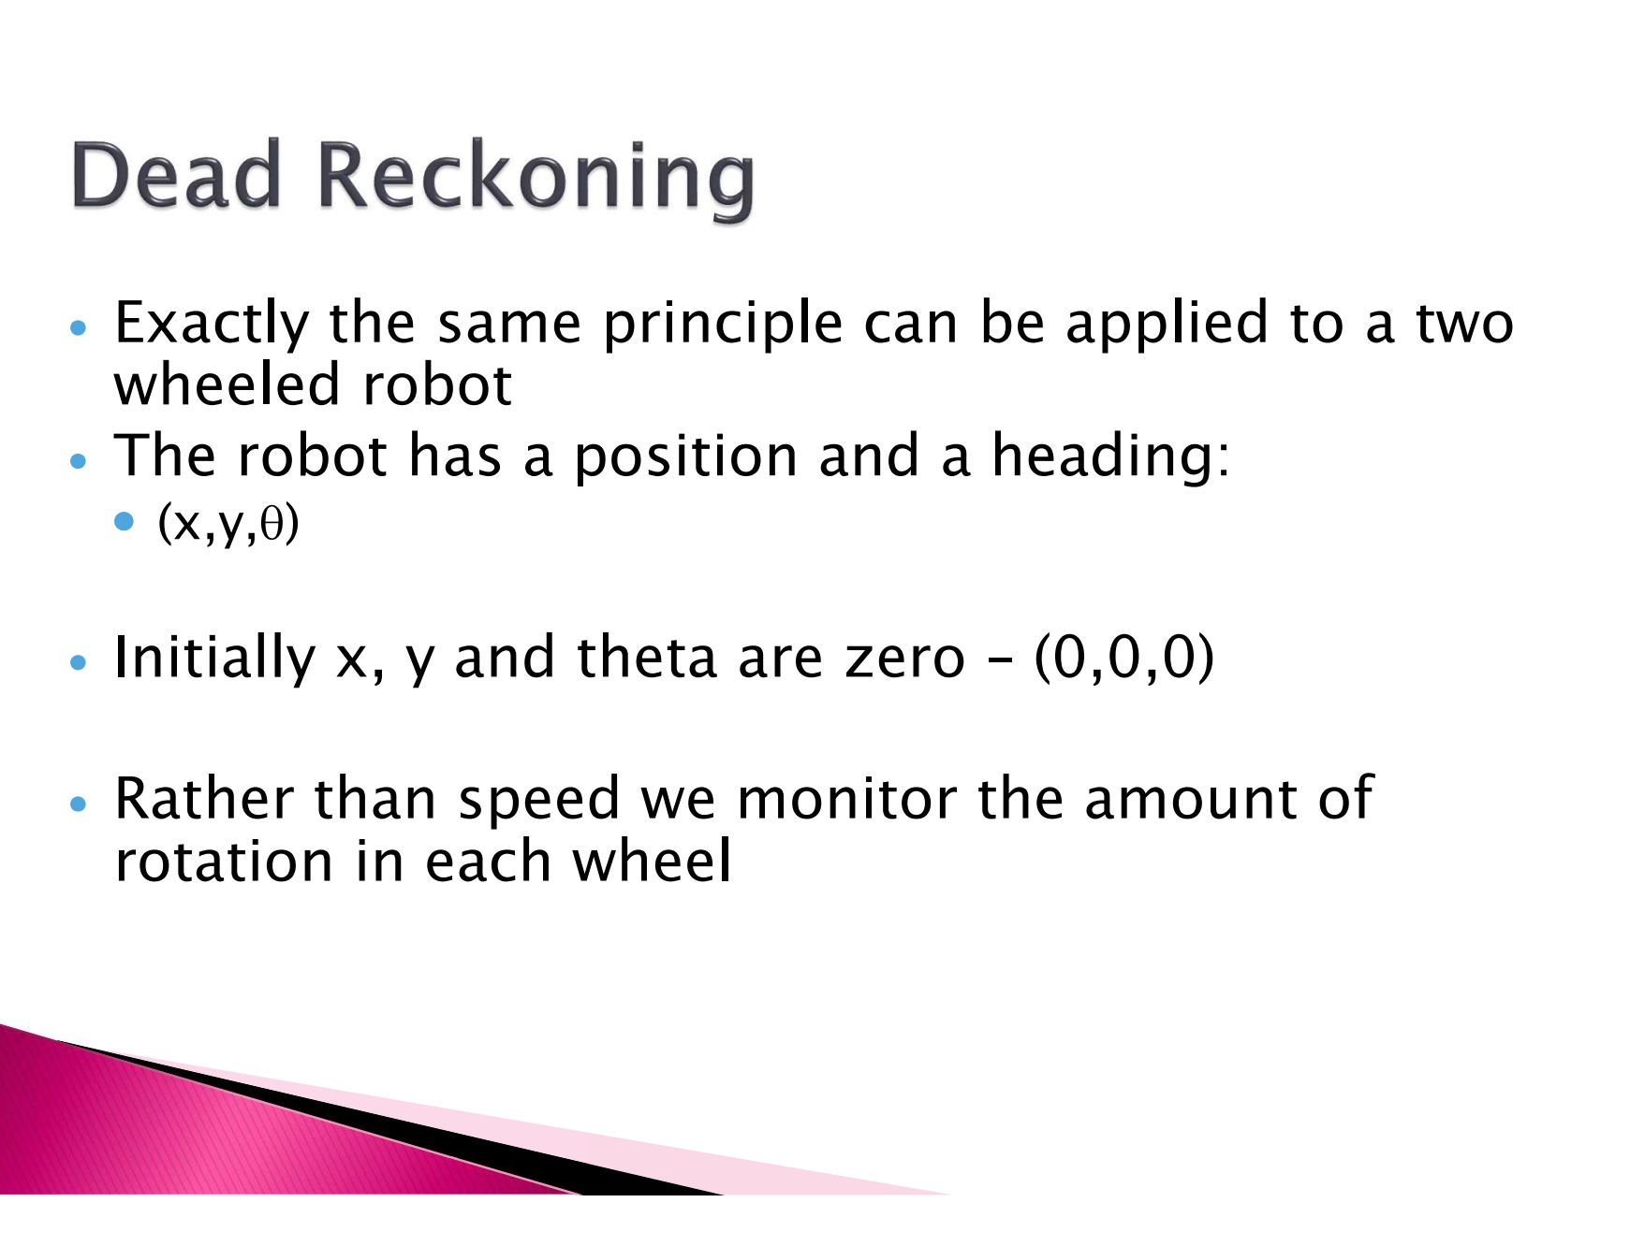

Slide 10
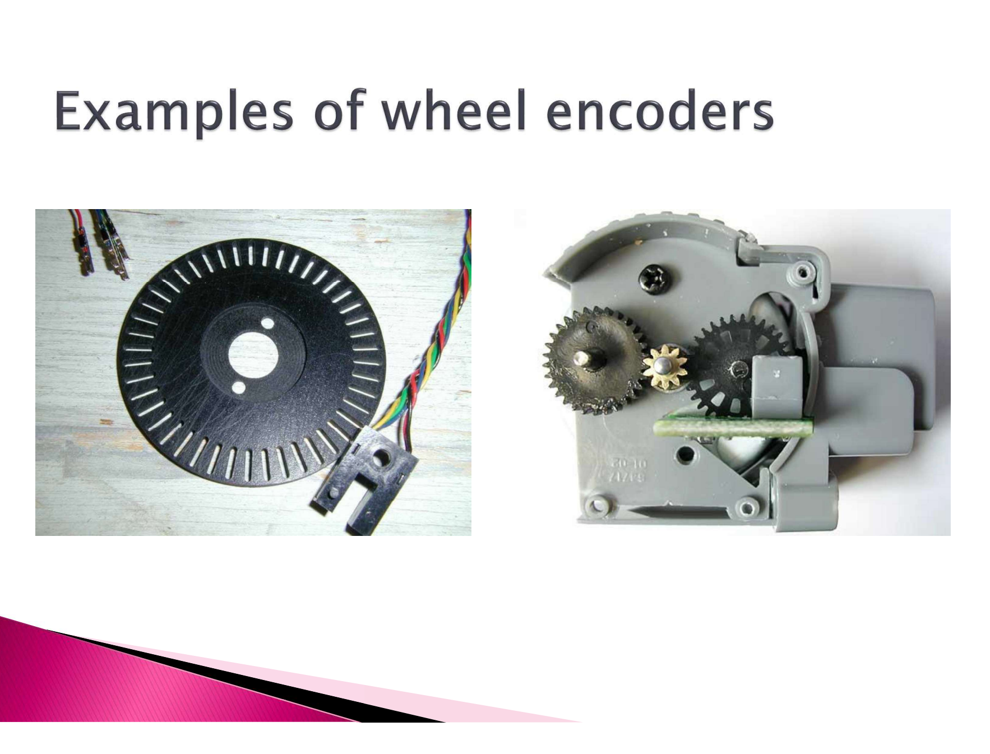

Slide 11
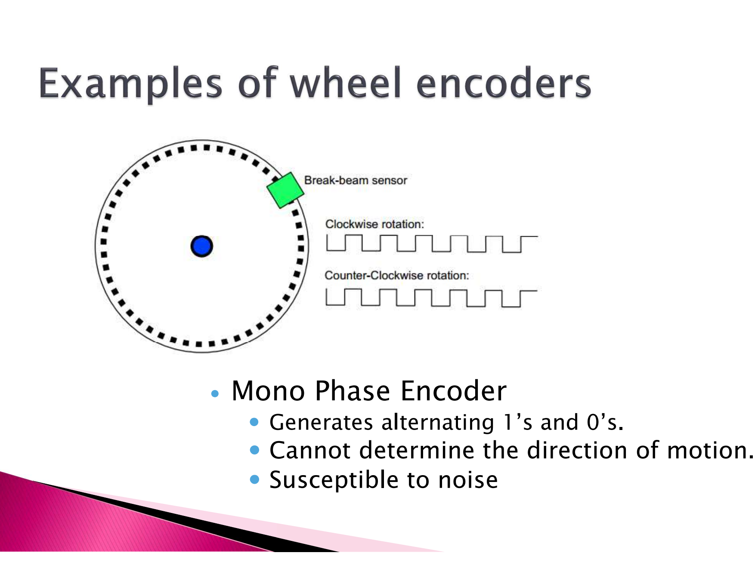

Slide 12
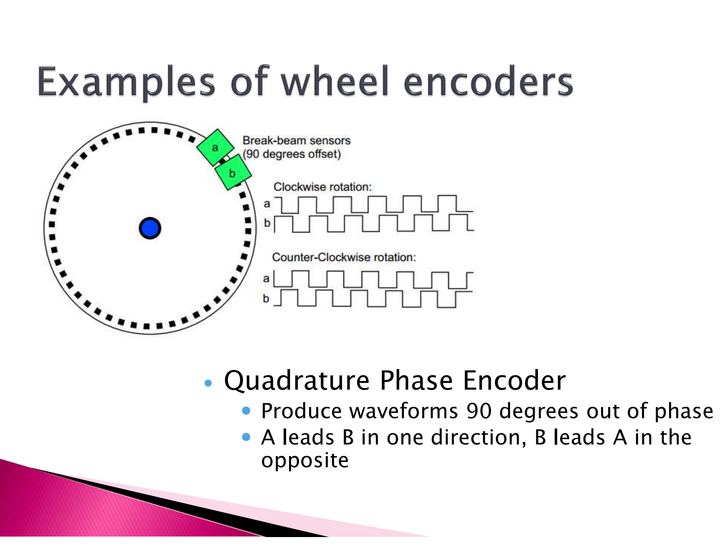

Slide 13
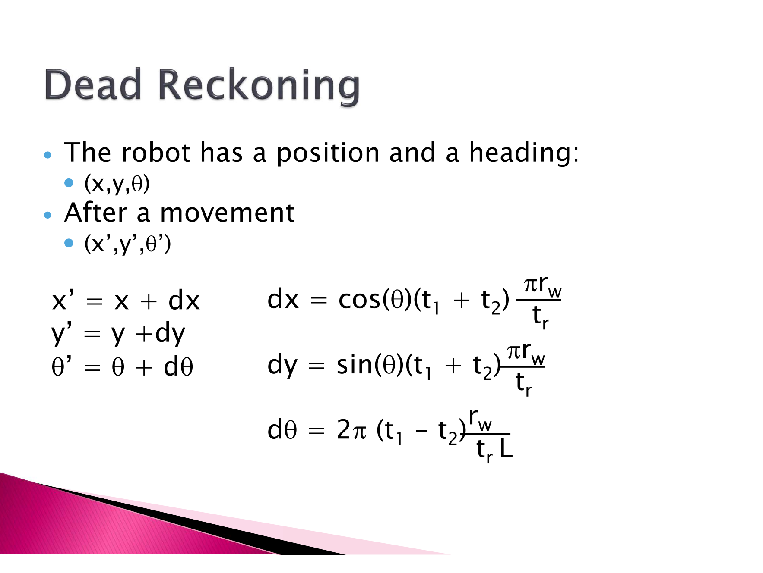

Slide 14
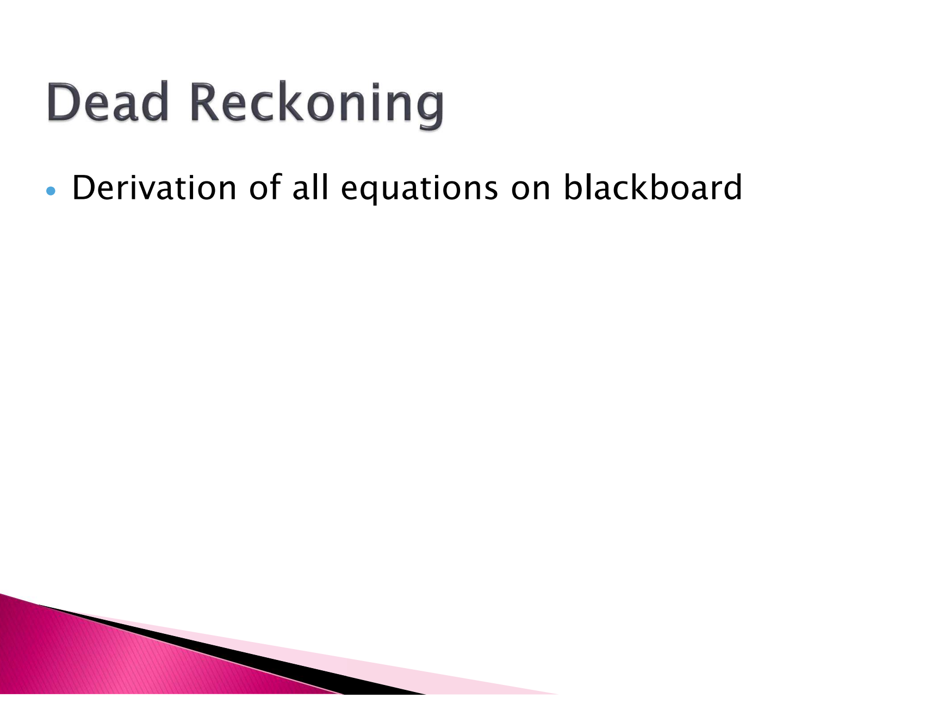

Slide 15
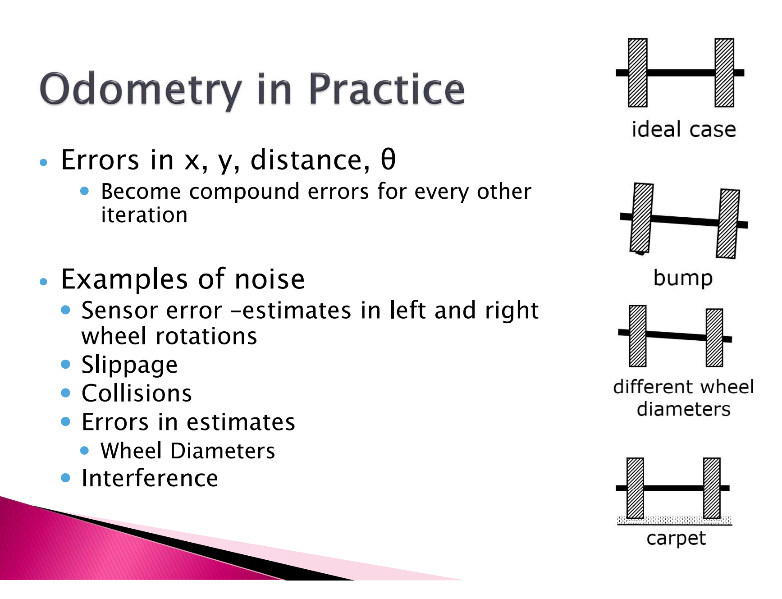

Slide 16
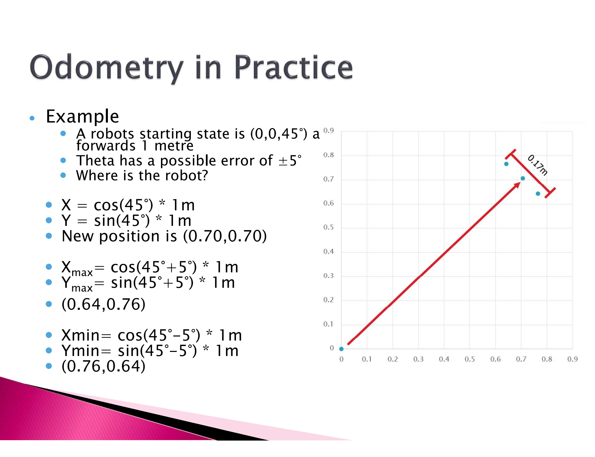

Slide 17
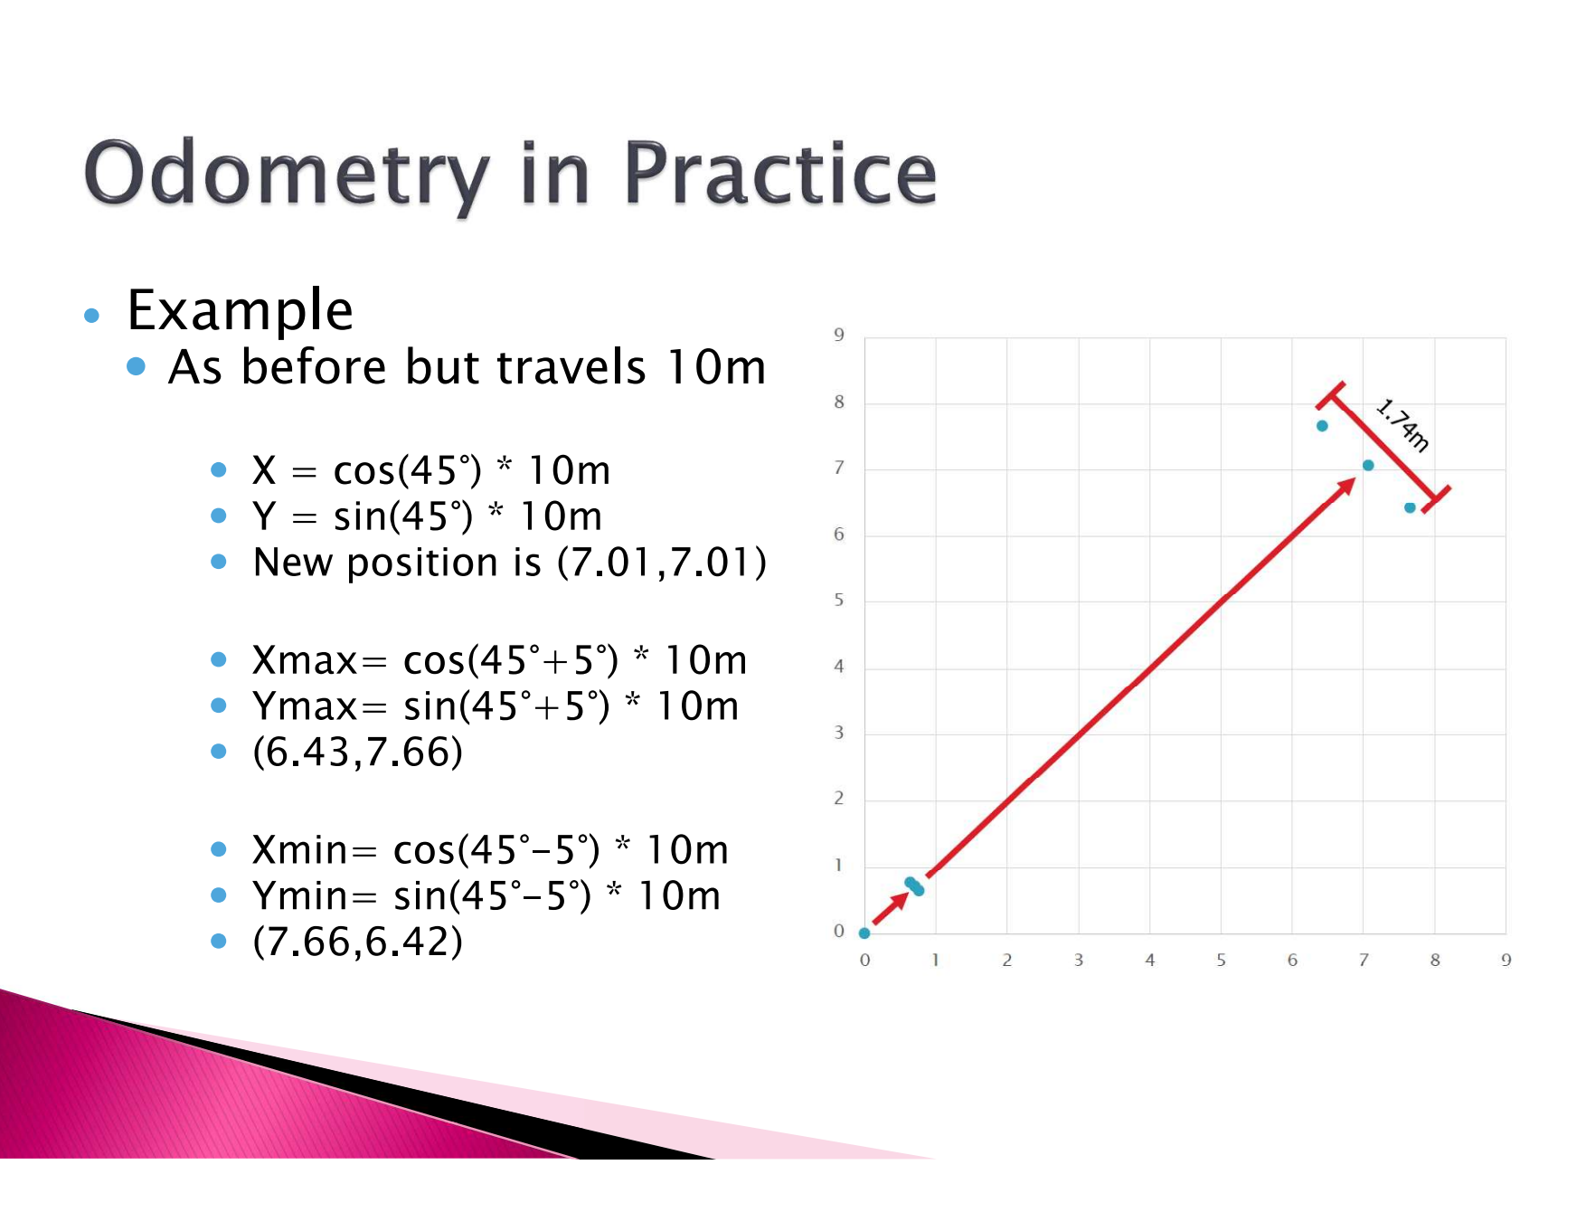

Slide 18
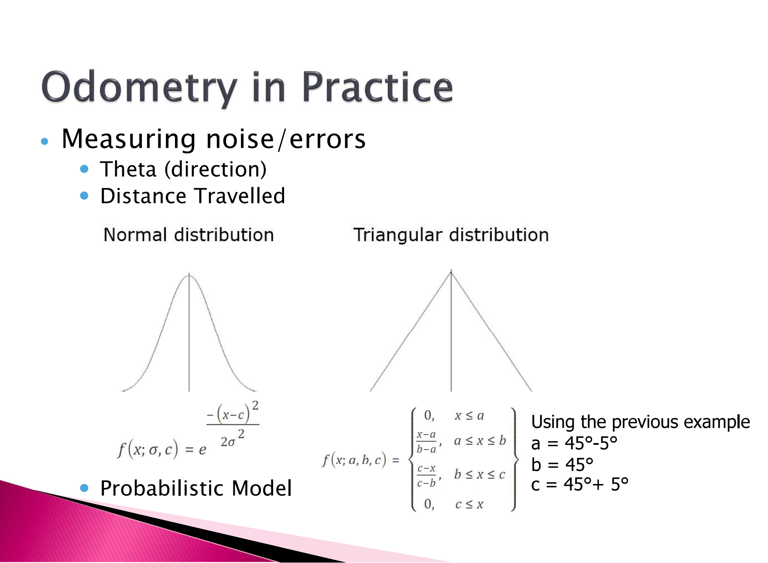

Slide 19
